Slide 1
STOCK PRICES ANALYSIS AND PREDICTION
19CSE352 – BUSINESS ANALYTICS

Slide 2
GROUP MEMBERS :
S.NO | NAME | ROLL NO
1 | K.RAHUL KRISHNA | CB.EN.U4CSE21029
2 | M.ROHIT | CB.EN.U4CSE21036
3 | M.SRIKAR | CB.EN.U4CSE21038
4 | P.B.PRANEETH | CB.EN.U4CSE21043
5 | T.VINAY KUMAR | CB.EN.U4CSE21063

Slide 3

STOCK
A stock, also known as a share of stock or equity, is a unit of ownership in a company that gives stockholders a claim on the company's earnings and assets. When a company sells stock, it's called an initial public offering (IPO), and investors become partial owners of the company. Stockholders can resell their shares on the stock market, and the price of a stock is usually based on expectations of the company's earnings.

Slide 4
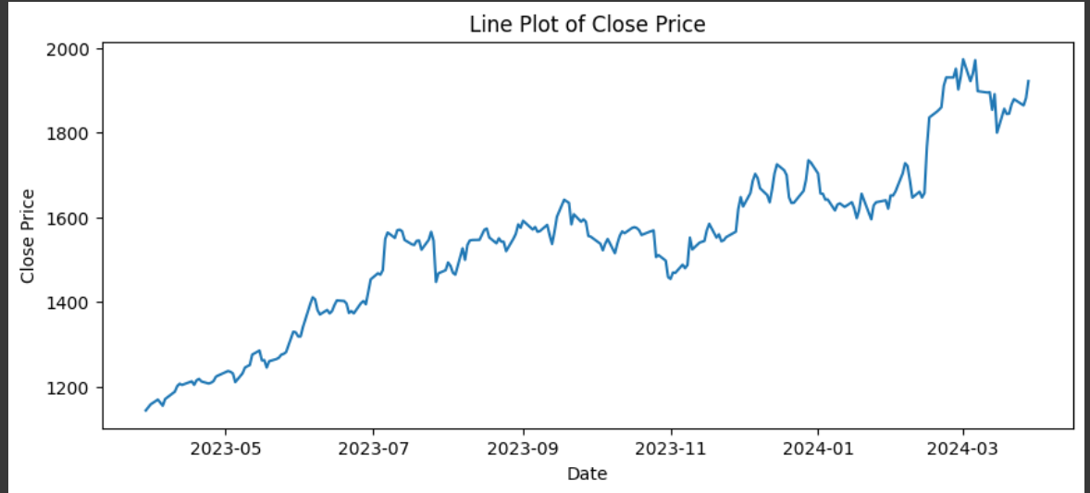
VISUALIZATION
Line Plot:
Line plots are fundamental for visualizing time series data.
They display data points connected by lines over time.
Line plots are excellent for identifying trends, seasonality, and overall patterns in the data.
They help in understanding how the values of a variable change over time.

Slide 5
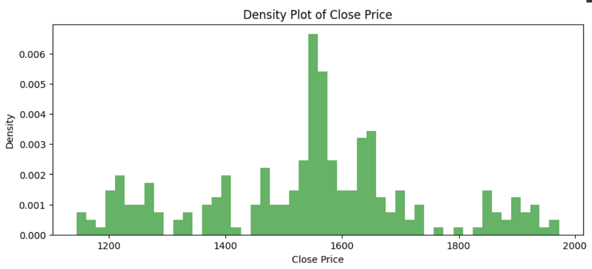
2.Density Plot:
Density plots show the distribution of values in a time series.
They provide insights into the central tendency and spread of the data over time.
Density plots are useful for understanding the shape of the distribution and identifying potential outliers or unusual patterns.

Slide 6
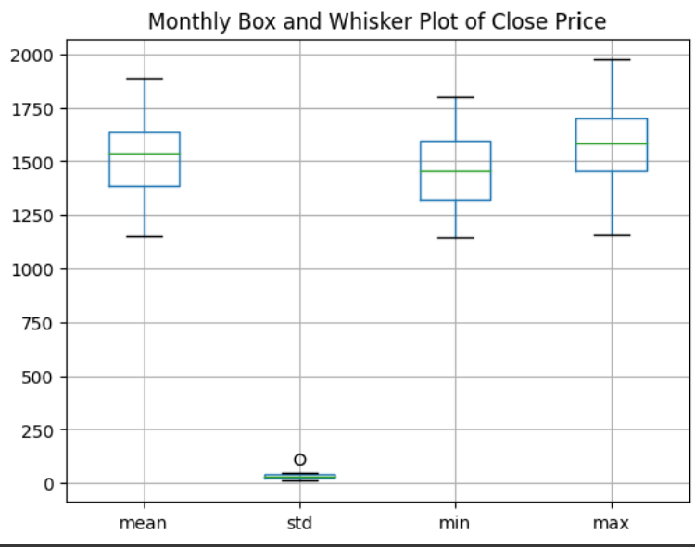
3.Box-and-Whisker Plot:
Box-and-whisker plots summarize the distribution of values in a time series.
They display summary statistics such as the median, quartiles, and potential outliers.
Box-and-whisker plots help in identifying the spread of the data and detecting any skewness or asymmetry in the distribution over time.
They are particularly useful for comparing the distribution of values across different time periods or categories.

Slide 7
STATIONARY CHECKS
Summary Statistics:
Stationary time series exhibit constant statistical properties over time, such as mean, variance, and autocorrelation.
By calculating summary statistics such as mean, variance, and autocorrelation at different time points or intervals, you can assess whether these properties remain relatively constant over time.
If the mean and variance vary significantly over time or exhibit a trend, seasonality, or other patterns, the time series may not be stationary.
Augmented Dickey-Fuller (ADF) Test:
The ADF test is a statistical hypothesis test used to determine whether a unit root is present in a time series.
A unit root indicates non-stationarity, implying that the time series has a stochastic or random trend.
The null hypothesis of the ADF test is that the time series has a unit root, suggesting non-stationarity.
If the p-value of the ADF test is less than a chosen significance level (e.g., 0.05), you can reject the null hypothesis and conclude that the time series is stationary.
The ADF test also provides a test statistic that can be compared to critical values to make this determination.

Slide 8
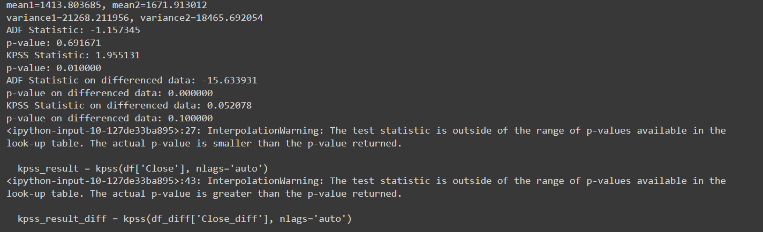
3.Kwiatkowski-Phillips-Schmidt-Shin (KPSS) Test:
The KPSS test is another statistical test used to assess the stationarity of a time series.
Unlike the ADF test, which tests for the presence of a unit root, the KPSS test tests for the presence of a deterministic trend in the data.
The null hypothesis of the KPSS test is that the time series is stationary around a deterministic trend.
If the p-value of the KPSS test is greater than a chosen significance level (e.g., 0.05), you fail to reject the null hypothesis, suggesting that the time series is stationary.
Conversely, if the p-value is less than the significance level, you reject the null hypothesis and conclude that the time series is non-stationary.

Slide 9
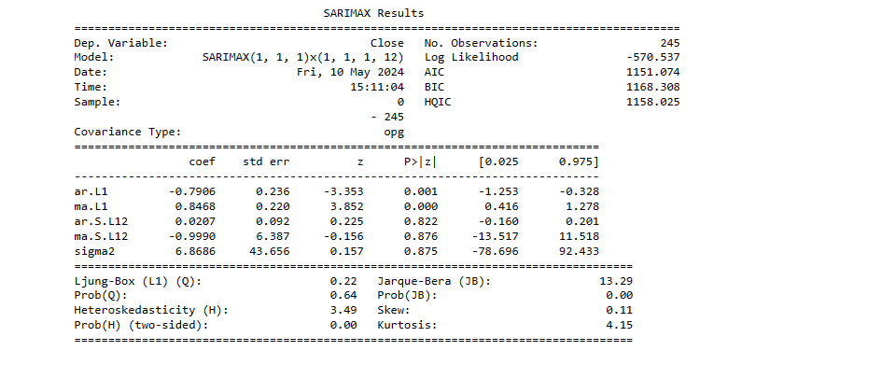
IDENTIFY PATTERN
Seasonal pattern:-
A seasonal pattern in time series data refers to fluctuations that occur at specific regular intervals due to seasonal factors. These patterns are predictable and repeat over a given period, such as a day, week, month, quarter, or year, depending on the context of the data. Seasonal patterns are crucial in many areas, including business planning, inventory management, staffing, and budgeting. Forecasting models, like SARIMAX (Seasonal AutoRegressive Integrated Moving Average with eXogenous regressors), explicitly incorporate seasonality to improve the accuracy of their predictions by accounting for these regular fluctuations. This allows businesses and analysts to anticipate future conditions more reliably based on past seasonal behavior

Slide 10
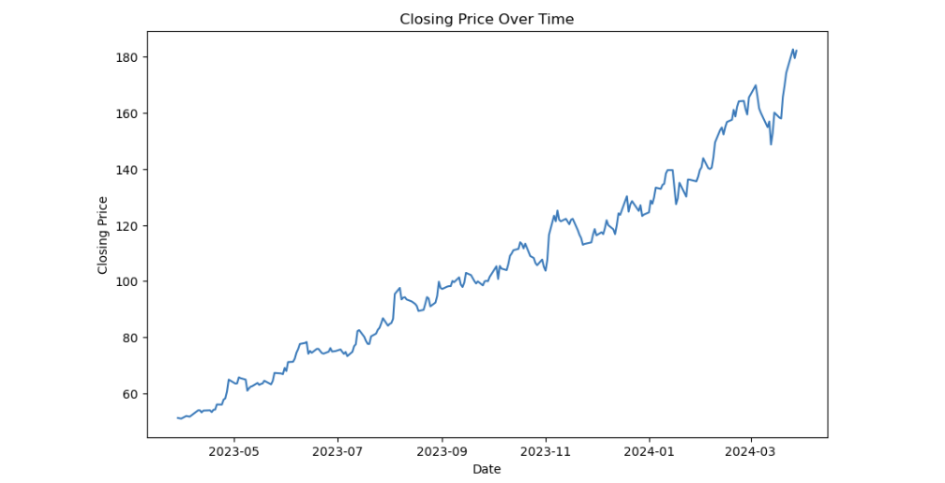
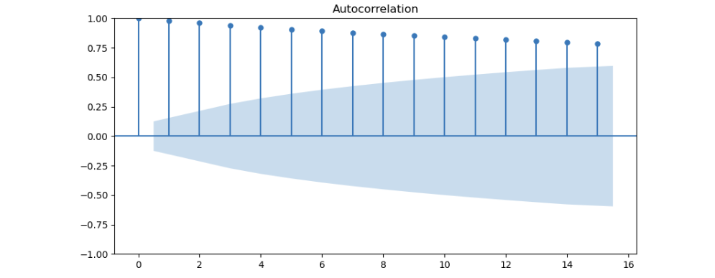
Plotting Closing Prices:-
It creates a line plot of the closing prices over time. This visual helps in understanding how the stock price has varied.
Autocorrelation and Partial Autocorrelation Plots:-
These plots help to identify the presence of any autocorrelation in the dataset. Autocorrelation refers to how correlated a series of data points is with its past values.
Partial autocorrelation gives the correlation of the series with its past values but after eliminating the variations already explained by the intervening comparisons.
The number of lags (15 in this case) indicates how many previous points each point is being compared to. These plots are crucial for determining the parameters of ARIMA-based models.

Slide 11
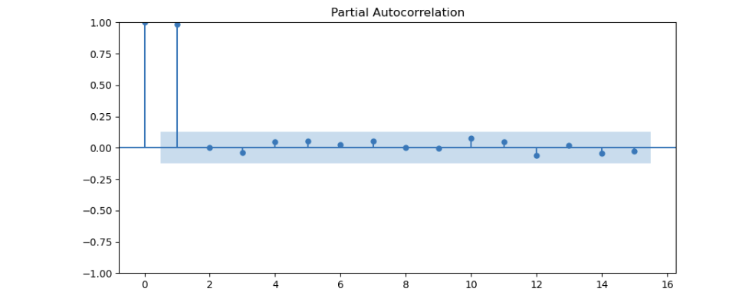
ARIMA Model Configuration:-
The parameters p, d, and q are specified for the ARIMA model. p represents the number of autoregressive terms, d the number of nonseasonal differences needed for stationarity, and q the number of lagged forecast errors in the prediction equation.
SARIMAX (Seasonal AutoRegressive Integrated Moving Average with eXogenous regressors model) is then configured. This model extends ARIMA to account for seasonality and can also handle external variables if provided. The seasonal parameters (1, 1, 1, 12) suggest an annual seasonality (12 months).
Model Fitting and Summary:-
The model is fit to the data, and a summary of the fit is printed. The summary provides detailed statistics about the model fit, including coefficients, standard errors, z-values, p-values, and various diagnostic tests.

Slide 12
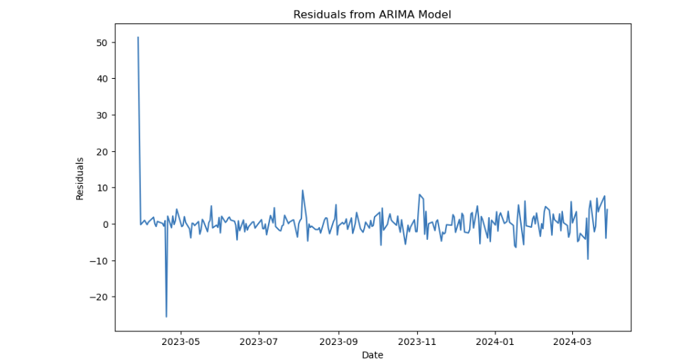
Plotting Residuals:
The residuals (differences between observed and predicted values) of the fitted model are plotted. Ideally, residuals should be white noise, meaning they should have constant variance and no pattern.
Overall, this is a comprehensive approach to understanding the behavior of stock prices through time series analysis and forecasting using advanced statistical modeling. By analyzing the autocorrelation and partial autocorrelation, the script can determine suitable parameters for the ARIMA model, and by applying the SARIMAX model, it attempts to make accurate predictions about future stock movements, adjusting for trends and seasonality

Slide 13
ARIMA
ARIMA is a very popular statistical method for time series forecasting. ARIMA stands for Auto-Regressive Integrated Moving Averages
ARIMA has three components – AR (autoregressive term), I (differencing term) and MA (moving average term). Let us understand each of these components
The value of ‘p’ is determined using the PACF plot.
The parameter ‘q’ in arima represents the MA term
Test like ADF can b used e to determine whether the series is stationary and help in identifying the d value

Slide 14
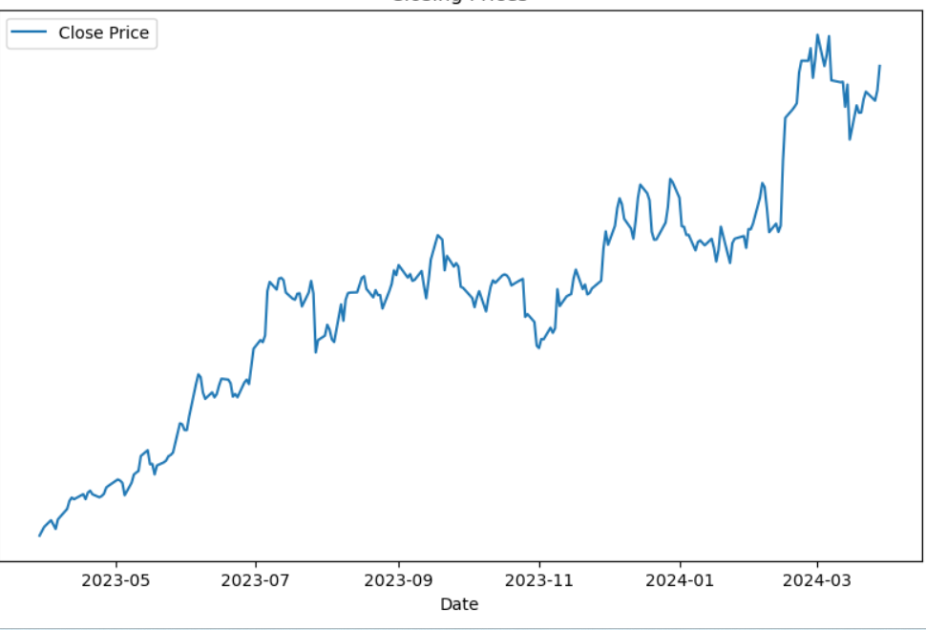
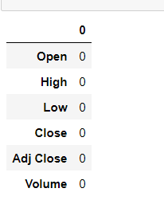
Implementation
Preliminary Analysis

Slide 15
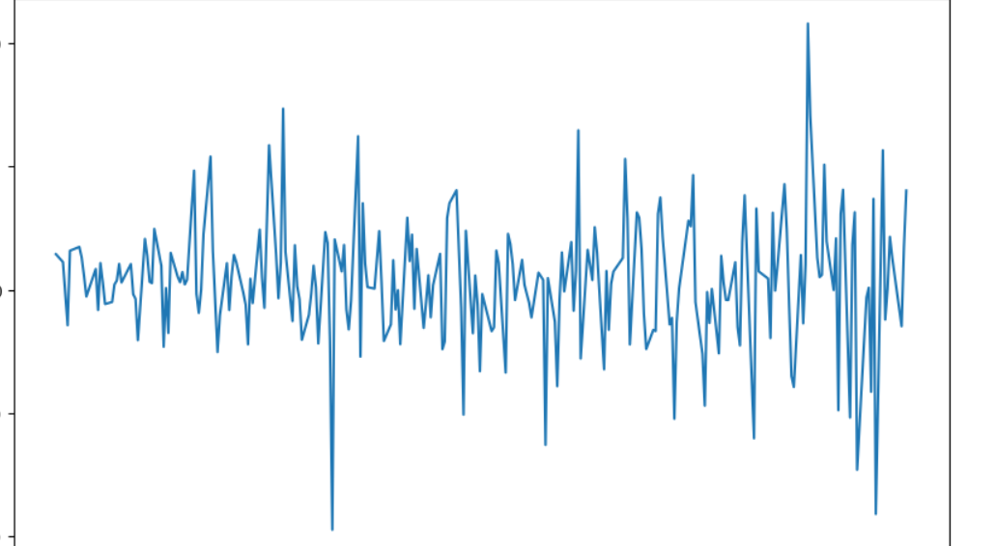
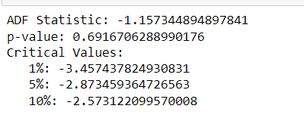
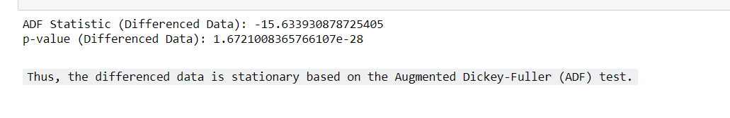
Augmented Dickey-Fuller (ADF)

Slide 16
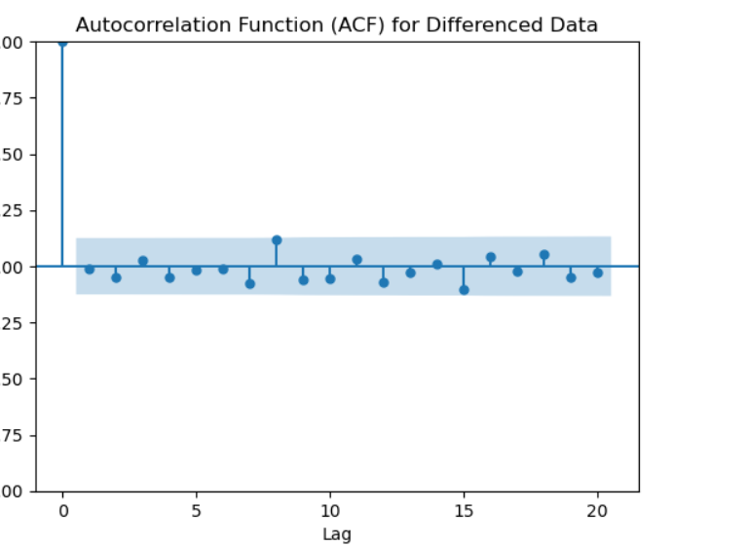
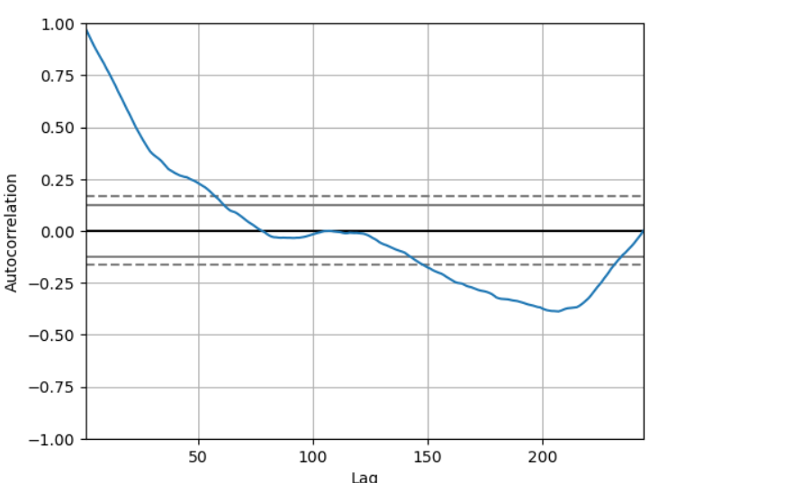
ACF(Autocorrelation Function)

Slide 17
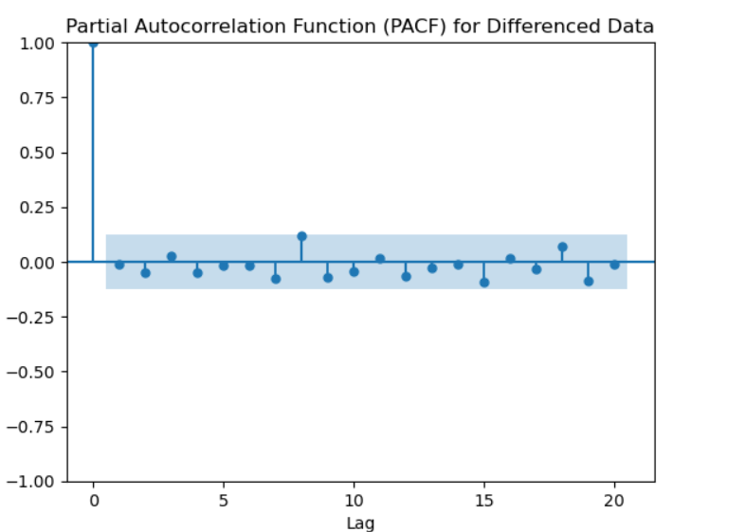
PACF(Partial Autocorrelation Function)

Slide 18
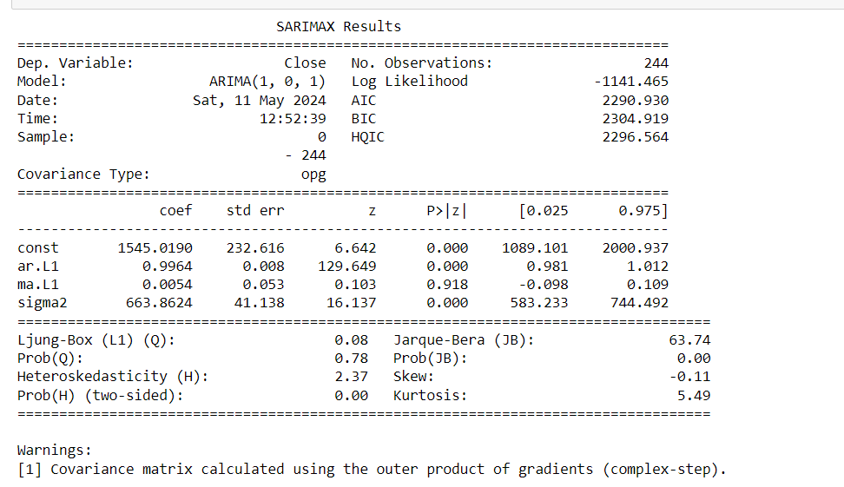
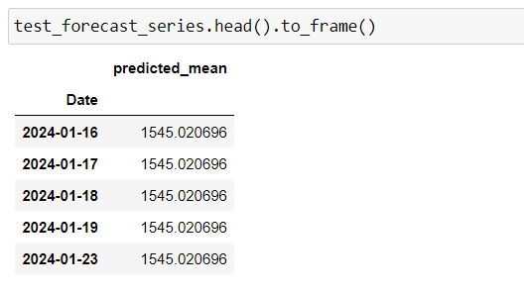
Model Summary And Forecasting

Slide 19
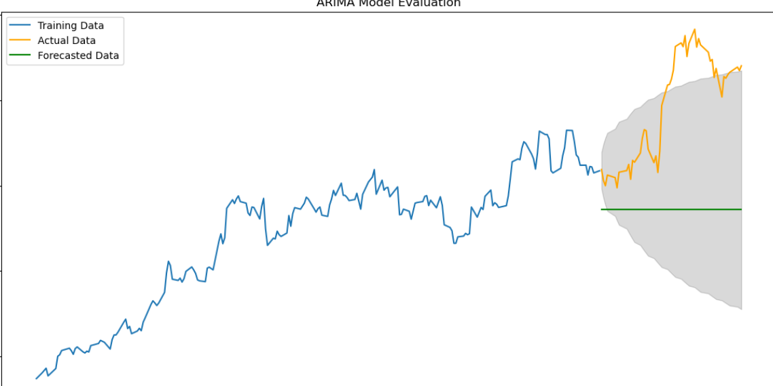
Plot with Prediction

Slide 20
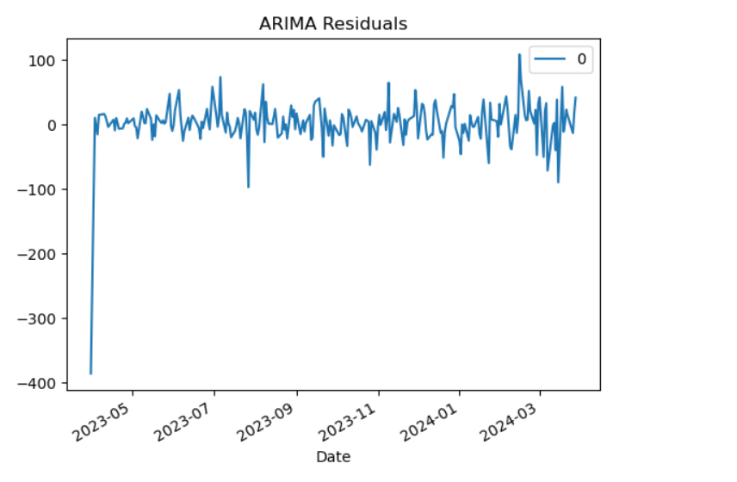
Residual Plot

Slide 21
Thank You !!

